Slide 1


Unit – 3 Domination & Matching in Graphs
B.Tech., B.Sc.(H) CS $→5$^{th} Semester
Graph theory (2301CS595)
CO3:
At the end of this unit, students will be able to
use domination and matching techniques. .
Prof. Punit Vadher
Department of Humanities & Science
punit.vadher@darshan.ac.in
9662443859

Slide 2

Topics of Unit 3
Introduction to Domination in Graphs
Closed neighborhood
Dominating Set
Domination Number and Total Domination
Matching in Graphs
Maximal Matching
Maximum Matching
Perfect Matching and Hall’s Theorem (without proof)
Looping

Slide 3
Brief Introduction

Slide 4
Brief Introduction of Unit
This unit focused on
Key Question: How can we use specific sets of vertices or edges to control or pair parts of a graph efficiently?
We learned about dominating sets, and domination number, showing how a small set of vertices can influence the whole graph.
These ideas are useful in real-world problems like network monitoring, resource placement, and spreading information.
We also studied matching, including maximal, maximum, and perfect matching, to understand how vertices can be paired without overlap.
Both domination and matching help to solve practical problems like job assignment, scheduling, and pairing tasks with resources.

Slide 5
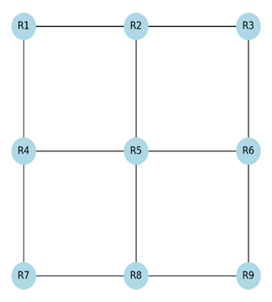
Real-life problem scenarios: Security Camera Placement
You are designing a security system for a museum with 12 rooms. Some rooms are connected by open hallways, and you are given a floor plan (represented as a graph). Your job is to place the minimum number of security cameras so that every room is either directly monitored or connected to a room with a camera.

Slide 6
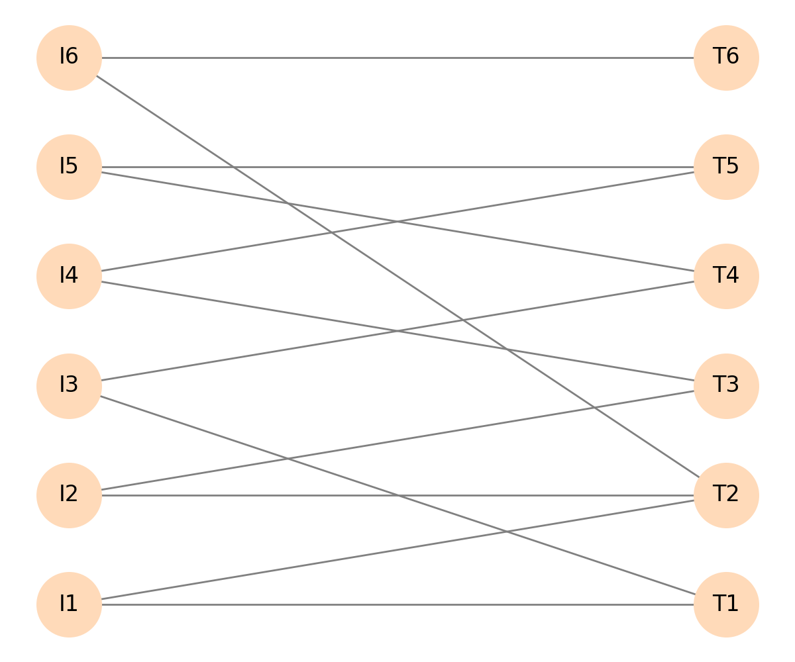
Real-life problem scenarios: Intern-Task Assignment
There are 6 interns and 6 different tasks. Each intern is skilled for certain tasks only (a list of possible intern task pairs is given). Your goal is to assign tasks so that each intern gets exactly one task, and no task is assigned to more than one intern, choosing the maximum possible assignments.

Slide 7
Method – 1 Introduction to Domination in Graphs: Dominating Set

Slide 8

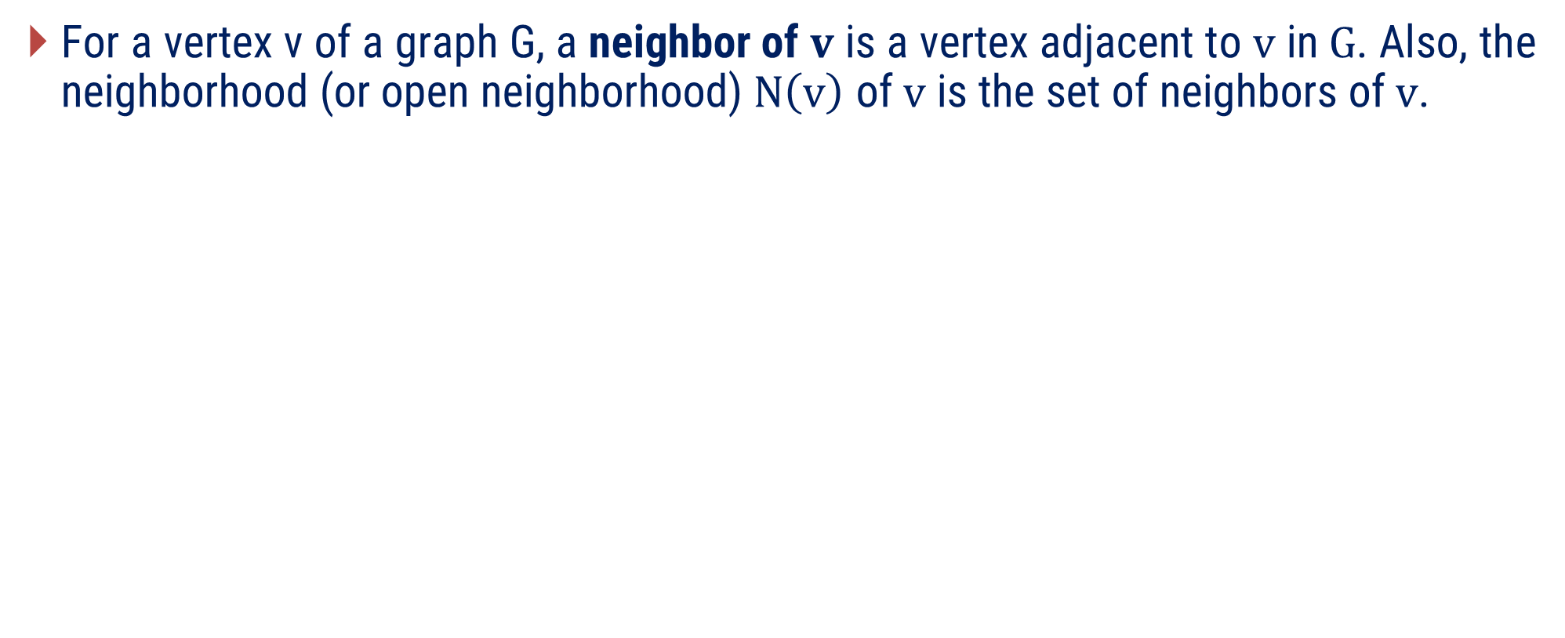
Important Terms
For a vertex v of a graph G, a neighbor of$v$ is a vertex adjacent to$v$ in$G$. Also, the neighborhood (or open neighborhood)$N\left(v\right)$ of$v$ is the set of neighbors of$v$.
v
e
d
a
c
b
$$N\left(v\right)=\left\{a,b,c\right\}$$

Slide 9

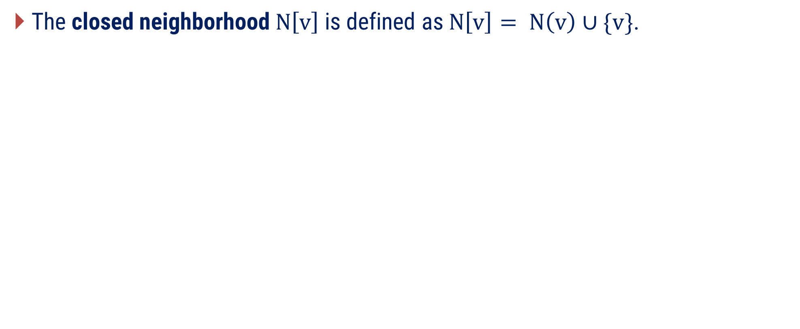
Important Terms
The closed neighborhood$N\left[v\right]$ is defined as$N\left[v\right]= N\left(v\right)∪\{v\}$.
v
e
d
a
c
b
$$N\left[v\right]=\left\{a,b,c,v\right\}$$

Slide 10
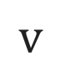
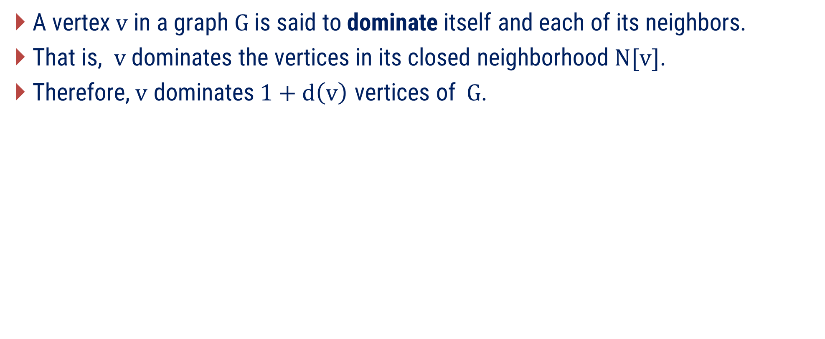
Important Terms
A vertex$v$ in a graph$G$ is said to dominate itself and each of its neighbors.
That is, $v$ dominates the vertices in its closed neighborhood$N[v]$.
Therefore,$v$ dominates$1+d\left(v\right)$ vertices of$G$.
$$v$$

Slide 11
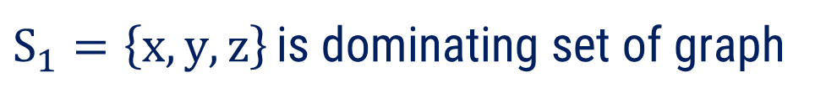
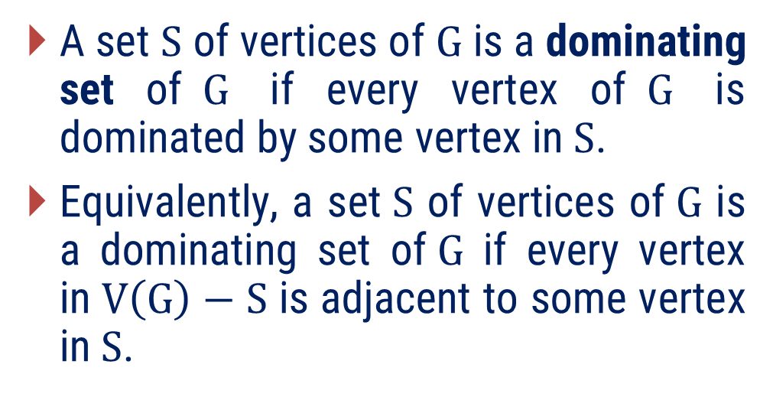
Dominating Set
A set$S$ of vertices of$G$ is a dominating set of$G$ if every vertex of$G$ is dominated by some vertex in$S$.
Equivalently, a set$S$ of vertices of$G$ is a dominating set of$G$ if every vertex in$V\left(G\right)−S$ is adjacent to some vertex in$S$.
x
h
g
e
f
y
c
d
$S_{1}=\left\{x,y,z\right\}$ is dominating set of graph
z
a
b

Slide 12
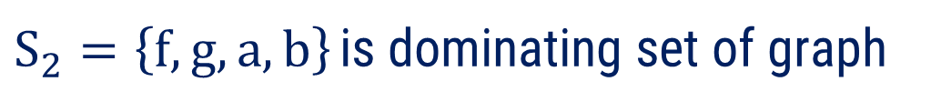
Dominating Set
A set$S$ of vertices of$G$ is a dominating set of$G$ if every vertex of$G$ is dominated by some vertex in$S$.
Equivalently, a set$S$ of vertices of$G$ is a dominating set of$G$ if every vertex in$V\left(G\right)−S$ is adjacent to some vertex in$S$.
x
h
g
e
f
y
c
d
$S_{2}=\left\{f,g,a,b\right\}$ is dominating set of graph
z
a
b

Slide 13
Examples of Method-1

Slide 14

Method 1 ⇝ Example 1
Can we dominate a 6x6 chessboard with 3 Queen?
Solution
First, we demonstrate how to dominate a 6×6 chessboard using Queens. Each Queen clearly covers the board as shown here.

Slide 15
Method 1 ⇝ Example 1
Can we dominate a 6x6 chessboard with 3 Queen?
Solution
No we cannot dominate a 6x6 chessboard with 3 Queen only.

Slide 16
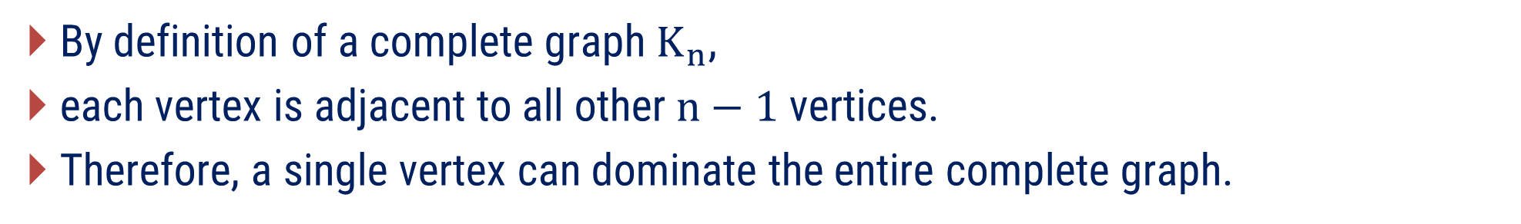
Method 1 ⇝ Example 1
What is dominating set of complete graph$K_{n}$? justify
Solution
By definition of a complete graph$K_{n}$,
each vertex is adjacent to all other$n−1$vertices.
Therefore, a single vertex can dominate the entire complete graph.

Slide 17
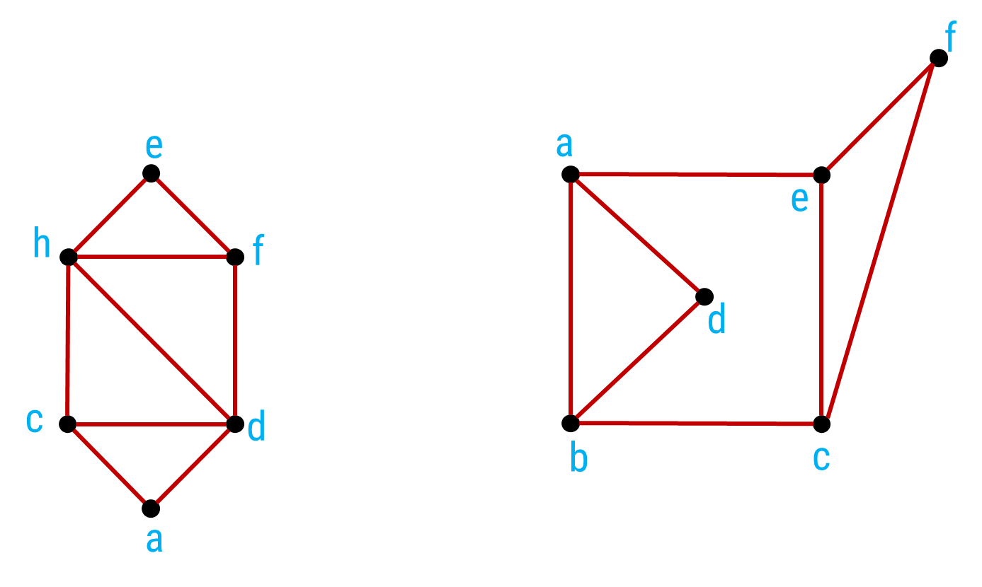
Method 1 ⇝ Example 1
Find any dominating set for the following graphs.
Solution

Slide 18

Method 1 ⇝ Example 1
Find any dominating set for the following graphs.
Solution
e
h
f
Dominating set for following graph is $\left\{e,a\right\}$.
c
d
a

Slide 19

Method 1 ⇝ Example 1
Find any dominating set for the following graphs.
Solution
f
a
Dominating set for following graph is $\left\{e,b\right\}$.
e
d
b
c

Slide 20
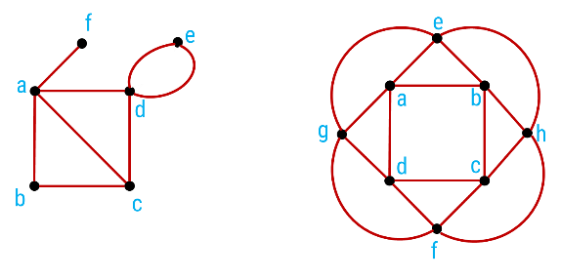
Method 1 ⇝ Example 1
Give at least 2 dominating set for each of the following graphs
Solution

Slide 21


Method 1 ⇝ Example 1
Give at least 2 dominating set for each of the following graphs
Solution
f
f
e
e
a
a
d
d
b
c
b
c
Dominating set $\left\{a,e\right\}$.
Dominating set $\left\{d,f,b\right\}$.

Slide 22


Method 1 ⇝ Example 1
Give at least 2 dominating set for each of the following graphs
Solution
e
e
a
b
a
b
g
h
g
h
d
c
d
c
f
f
Dominating set $\left\{e,f\right\}$.
Dominating set $\left\{a,c\right\}$.

Slide 23
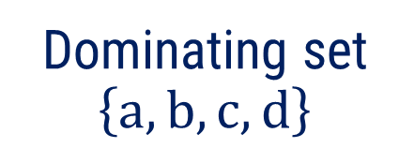
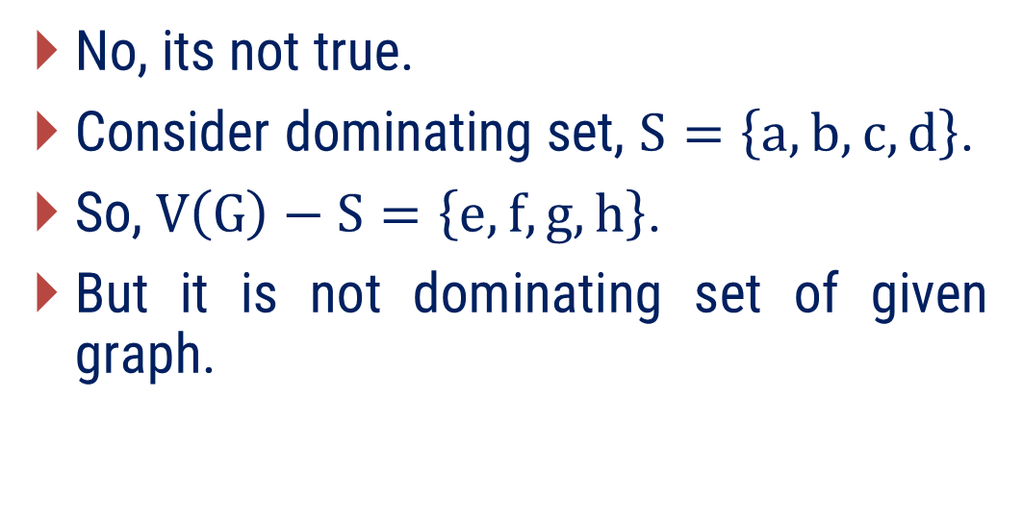
Method 1 ⇝ Example 1
Justify following statement:
Let G be a graph without isolated vertices. If S is a dominating set of G, then V(G) − S is a dominating set of G.
Solution
f
e
No, its not true.
Consider dominating set, $S=\left\{a,b, c,d\right\}$.
So, $V\left(G\right)−S=\left\{e,f,g,h\right\}$.
But it is not dominating set of given graph.
a
b
c
d
g
h
Dominating set $\left\{a,b, c,d\right\}$

Slide 24
Method – 2 Domination Number and Total Domination

Slide 25
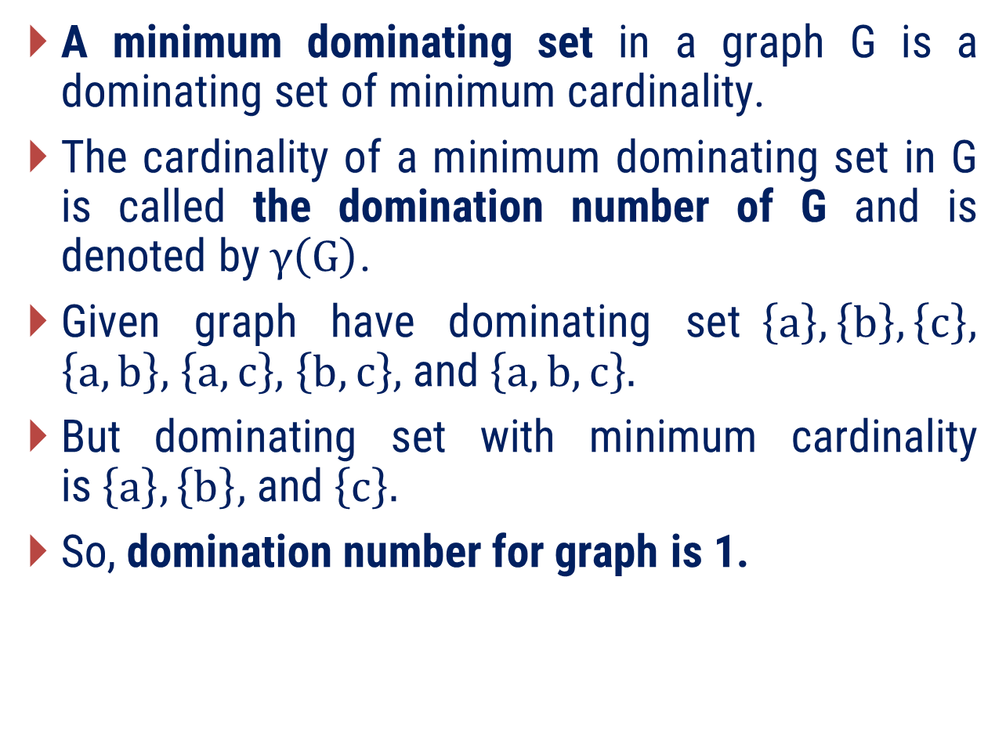
Dominating Set
A minimum dominating set in a graph G is a dominating set of minimum cardinality.
The cardinality of a minimum dominating set in G is called the domination number of G and is denoted by$γ\left(G\right)$.
Given graph have dominating set$\left\{a\right\},\left\{b\right\},\left\{c\right\},$ $\left\{a,b\right\},$ $\left\{a,c\right\},$ $\left\{b,c\right\},$ and$\left\{a,b,c\right\}.$
But dominating set with minimum cardinality is$\left\{a\right\},\left\{b\right\},$ and$\left\{c\right\}.$
So, domination number for graph is 1.
a
c
b

Slide 26
Find domination number of below graph
x
h
g
e
f
y
c
d
z
a
b

Slide 27
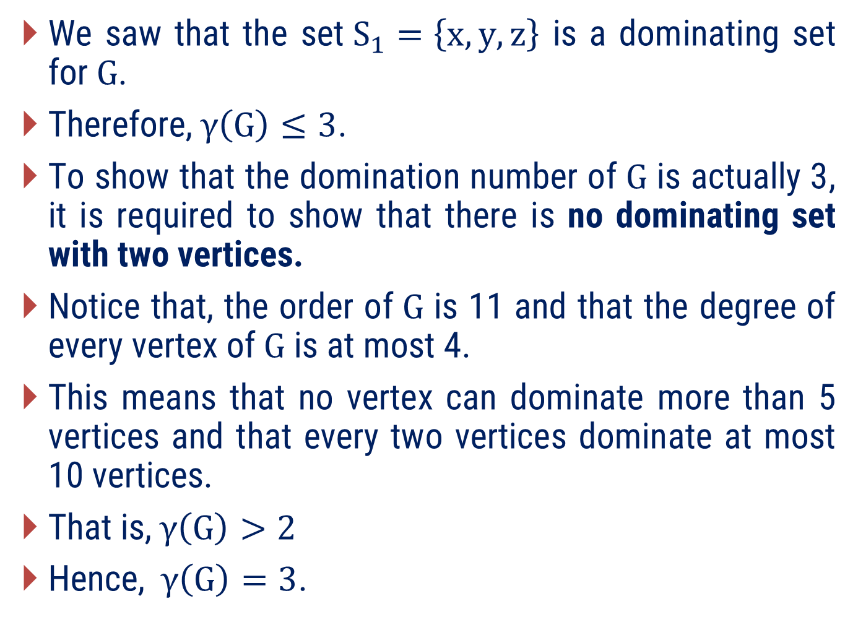
Find domination number of below graph
We saw that the set$S_{1}=\left\{x, y, z\right\}$ is a dominating set for$G$.
Therefore,$γ\left(G\right)≤3$.
To show that the domination number of$G$ is actually 3, it is required to show that there is no dominating set with two vertices.
Notice that, the order of$G$ is 11 and that the degree of every vertex of$G$ is at most 4.
This means that no vertex can dominate more than 5 vertices and that every two vertices dominate at most 10 vertices.
That is,$γ\left(G\right)>2$
Hence,$γ\left(G\right)=3$.
x
h
g
e
f
y
c
d
z
a
b

Slide 28
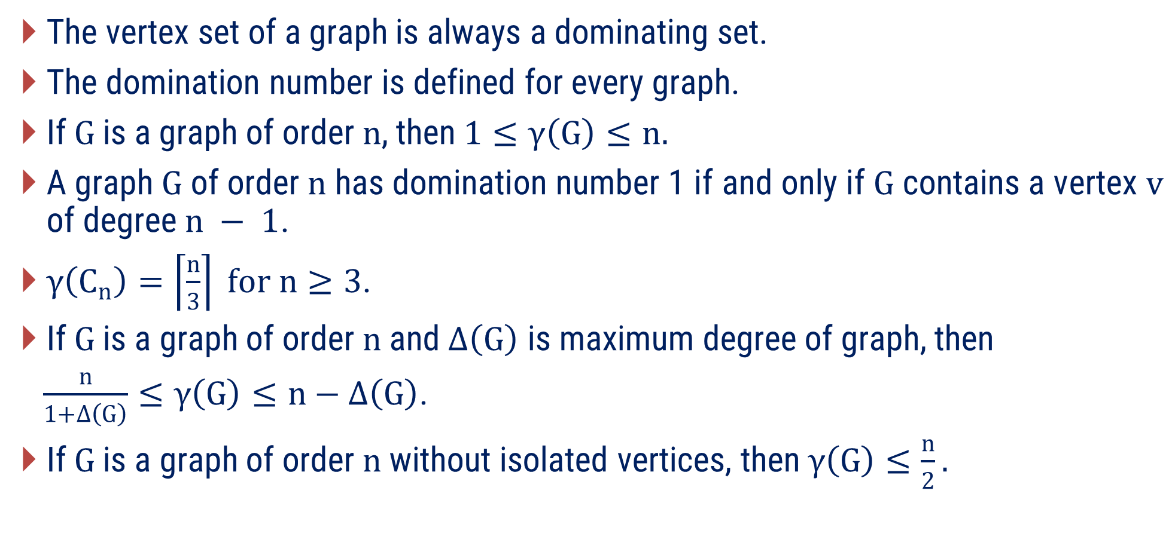
Remarks
The vertex set of a graph is always a dominating set.
The domination number is defined for every graph.
If$G$is a graph of order$n$, then$1≤γ\left(G\right)≤n.$
A graph$G$ of order$n$ has domination number 1 if and only if$G$ contains a vertex$v$ of degree$n − 1$.
$γ\left(C_{n}\right)=\left\lceil \frac{n}{3}\right\rceil for n≥3$.
If$G$ is a graph of order$n$ and $Δ\left(G\right)$ is maximum degree of graph, then
$\frac{n}{1+Δ\left(G\right)}≤γ\left(G\right)≤n−Δ\left(G\right)$.
If$G$ is a graph of order$n$ without isolated vertices, then$γ\left(G\right)≤\frac{n}{2}.$

Slide 29
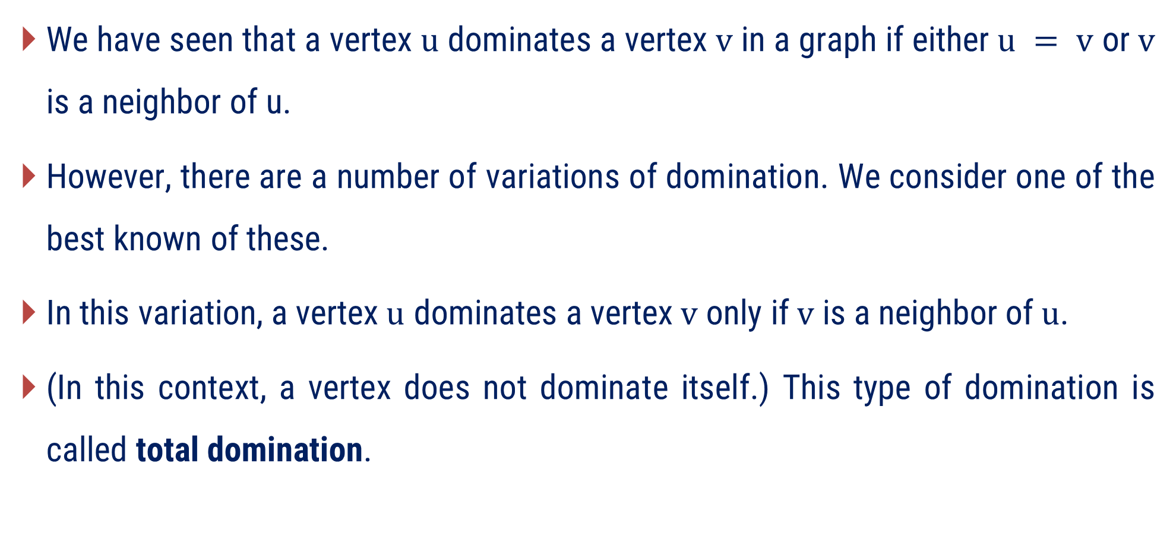
Total Domination
We have seen that a vertex$u$ dominates a vertex$v$ in a graph if either$u = v$ or$v$ is a neighbor of u.
However, there are a number of variations of domination. We consider one of the best known of these.
In this variation, a vertex$u$ dominates a vertex$v$ only if$v$ is a neighbor of$u$.
(In this context, a vertex does not dominate itself.) This type of domination is called total domination.

Slide 30
Domination vs. Total Domination
2 vertices will dominate graph
2 vertices will not totally dominate graph

Slide 31
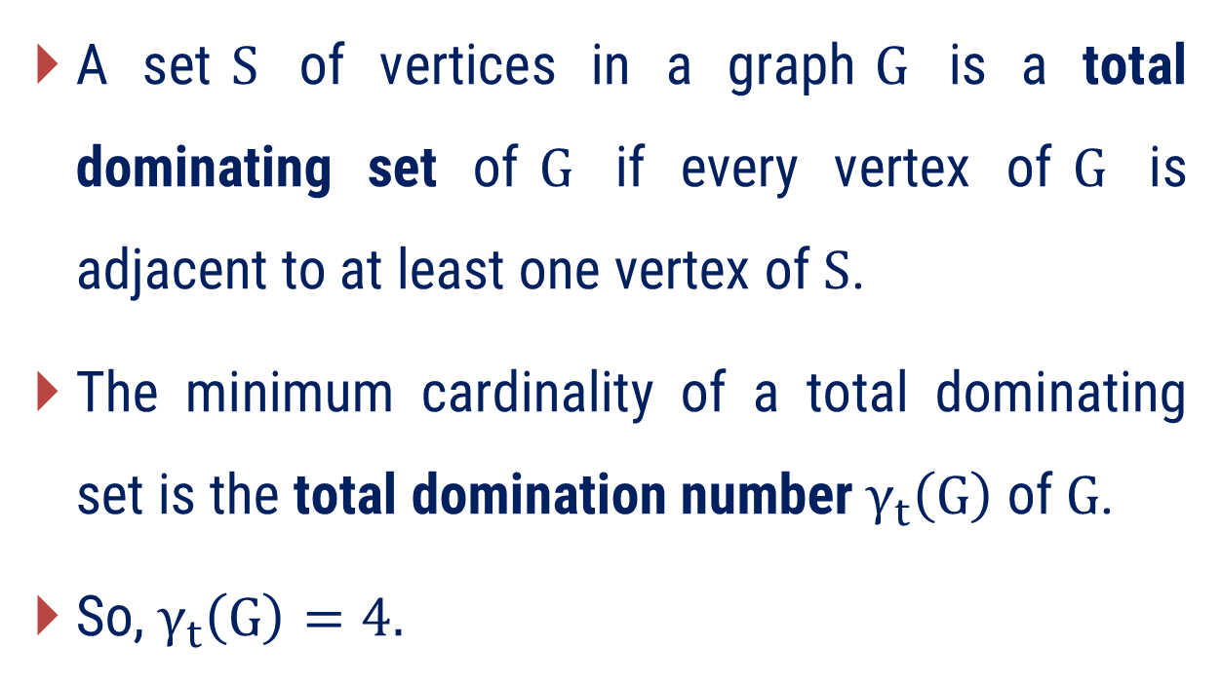
Total Domination Number
A set$S$ of vertices in a graph$G$ is a total dominating set of$G$ if every vertex of$G$ is adjacent to at least one vertex of$S$.
The minimum cardinality of a total dominating set is the total domination number$γ_{t}\left(G\right)$ of$G$.
So, $γ_{t}\left(G\right)=4.$

Slide 32
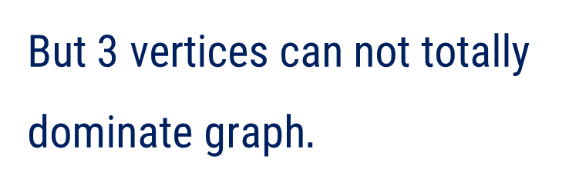

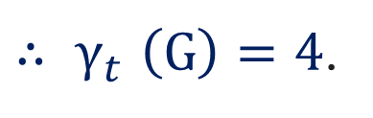
Find the Total Domination Number
x
h
g
We know that, $γ\left(G\right)=3.$
But 3 vertices can not totally dominate graph$.$
e
y
f
c
d
${∴ γ}_{t}\left(G\right)=4$.
z
a
b

Slide 33
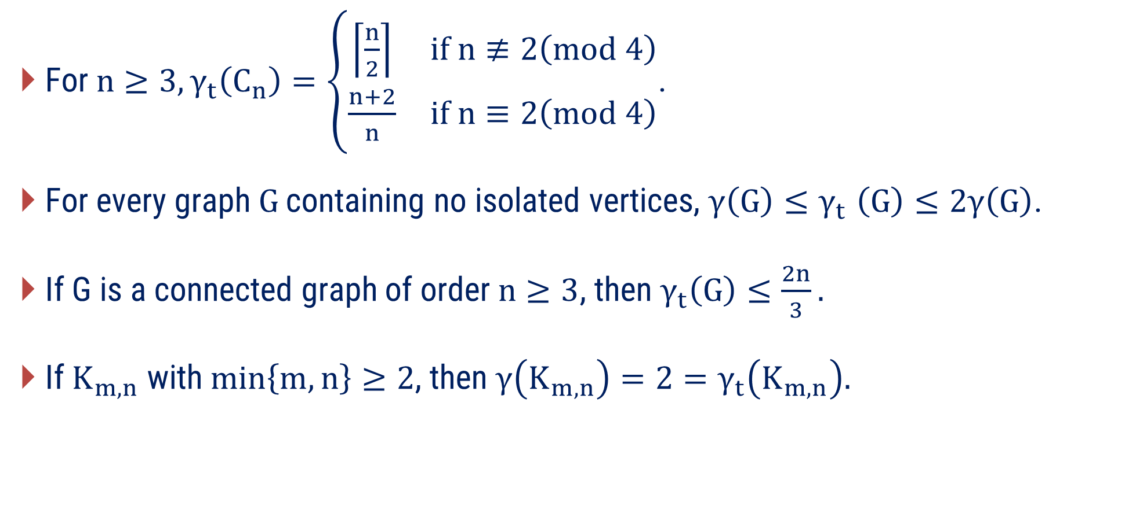
Remarks
For$n≥3,γ_{t}\left(C_{n}\right)=\left\{\begin{matrix}\left\lceil \frac{n}{2}\right\rceil & if n≢2\left(mod 4\right) \\ \frac{n+2}{n} & if n≡2\left(mod 4\right)\end{matrix}\right.$.
For every graph$G$ containing no isolated vertices, $γ\left(G\right){≤γ}_{t}\left(G\right)≤2γ\left(G\right)$.
If G is a connected graph of order$n≥3$, then $γ_{t}\left(G\right)≤\frac{2n}{3}.$
If $K_{m,n}$ with$\min\left\{m,n\right\}≥2$, then $γ\left(K_{m,n}\right)=2=γ_{t}\left(K_{m,n}\right).$

Slide 34
Examples of Method-2

Slide 35
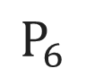
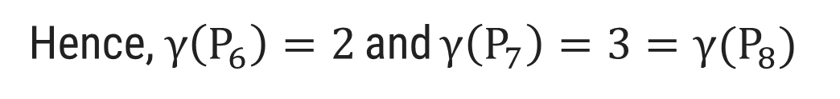
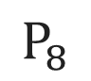
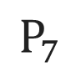
Method 2 ⇝ Example 1
Find the domination number for $P_{n} and C_{n}, 6≤n≤8.$
Solution
$$P_{6}$$
$$P_{7}$$
$$P_{8}$$
Hence,$γ\left(P_{6}\right)=2$ and $γ\left(P_{7}\right)=3={γ(P}_{8})$

Slide 36
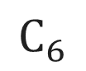
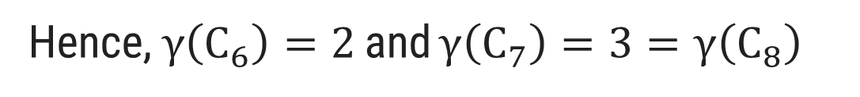
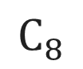
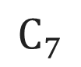
Method 2 ⇝ Example 1(Cont.)
Find the domination number for $P_{n} and C_{n}, 6≤n≤8.$
Solution
$$C_{6}$$
$$C_{7}$$
$$C_{8}$$
Hence,$γ\left(C_{6}\right)=2$ and $γ\left(C_{7}\right)=3=γ\left(C_{8}\right)$

Slide 37
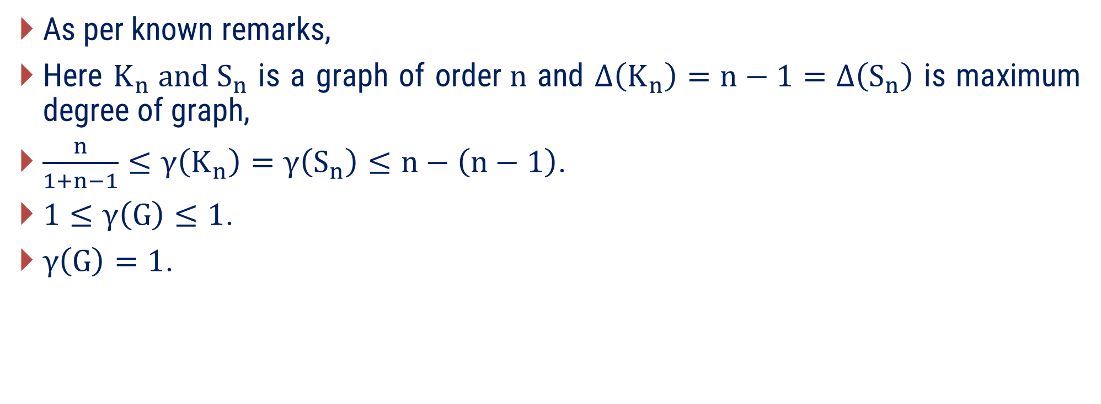
Method 2 ⇝ Example 2
Prove mathematically that the domination number for$K_{n}$ and$S_{n}$ are 1.
Solution
As per known remarks,
Here $K_{n} and S_{n}$ is a graph of order$n$ and $Δ\left(K_{n}\right)=n−1=Δ\left(S_{n}\right)$ is maximum degree of graph,
$\frac{n}{1+n−1}≤γ\left(K_{n}\right)=γ\left(S_{n}\right)≤n−\left(n−1\right)$.
$1≤γ\left(G\right)≤1$.
$γ\left(G\right)=1$.

Slide 38
Method 2 ⇝ Example 3
Determine the domination number and total domination number for the given graphs.

Slide 39
Method 2 ⇝ Example 3
Determine the domination number and total domination number for the given graphs.
Solution
Domination Number
Total Domination Number
Domination Number = 2
Total Domination Number = 4

Slide 40
Method 2 ⇝ Example 4
Find the domination number and total domination number of$K_{2,3}$.
Solution
Domination Number
Total Domination Number
Domination Number = 2
Total Domination Number = 2

Slide 41
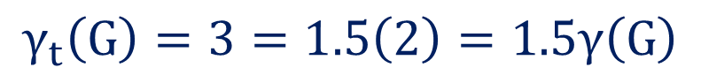
Method 2 ⇝ Example 5
Give an example of a connected graph$G$ such that$γ_{t}\left(G\right)=1.5γ\left(G\right)$.
Solution
For Domination Number
For Total Domination Number
That means domination number is 2 for given graph
That means total domination number is 3 for given graph
$$γ_{t}\left(G\right)=3=1.5\left(2\right)=1.5γ\left(G\right)$$

Slide 42
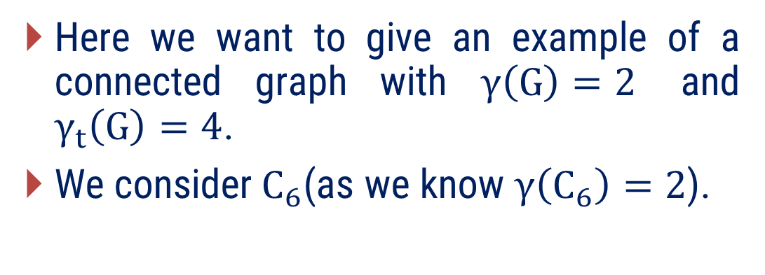
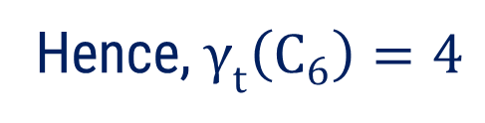
Method 2 ⇝ Example 6
Give an example of a connected graph$G$ such that
$γ\left(G\right)=2$ and $γ_{t}\left(G\right)=4$
Solution
For total domination,
Here we want to give an example of a connected graph with $γ\left(G\right)=2$ and $γ_{t}\left(G\right)=4$.
We consider$C_{6}$(as we know $γ\left(C_{6}\right)=2$).
Hence,${ γ}_{t}\left(C_{6}\right)=4$

Slide 43
Method – 3 Matching, Maximal Matching and Maximum Matching

Slide 44
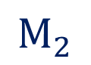
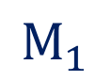
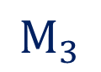
Matching
A matching in a graph is a subset of edges in which no two edges are adjacent.
a
a
a
a
c
b
c
b
c
b
c
b
G
$$M_{1}$$
$$M_{2}$$
$$M_{3}$$
A single edge in a graph is obviously a matching.

Slide 45
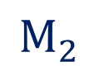

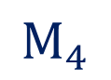
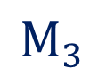
Matching
A matching in a graph is a subset of edges in which no two edges are adjacent.
G
$$M_{1}$$
$$M_{2}$$
$$M_{3}$$
$$M_{4}$$

Slide 46

Maximal Matching
A maximal matching is a matching to which no edge in the graph can be added.
a
a
a
a
c
b
c
b
c
b
c
b
G
$$M_{1}$$
$$M_{2}$$
$$M_{3}$$
Here all three are maximal matching.
In a$K_{3}$ any single edge is a maximal matching.

Slide 47
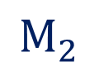

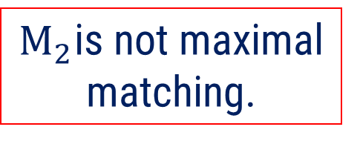
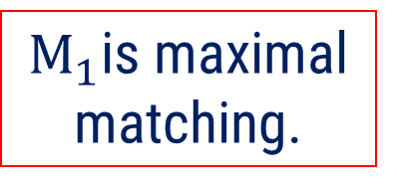
Maximal Matching
A maximal matching is a matching to which no edge in the graph can be added.
G
$$M_{1}$$
$$M_{2}$$
$M_{1}$is maximal matching.
$M_{2}$is not maximal matching.

Slide 48




Maximal Matching
A maximal matching is a matching to which no edge in the graph can be added.
G
$$M_{1}$$
$$M_{2}$$
$M_{1}$is maximal matching.
$M_{2}$is not maximal matching.

Slide 49
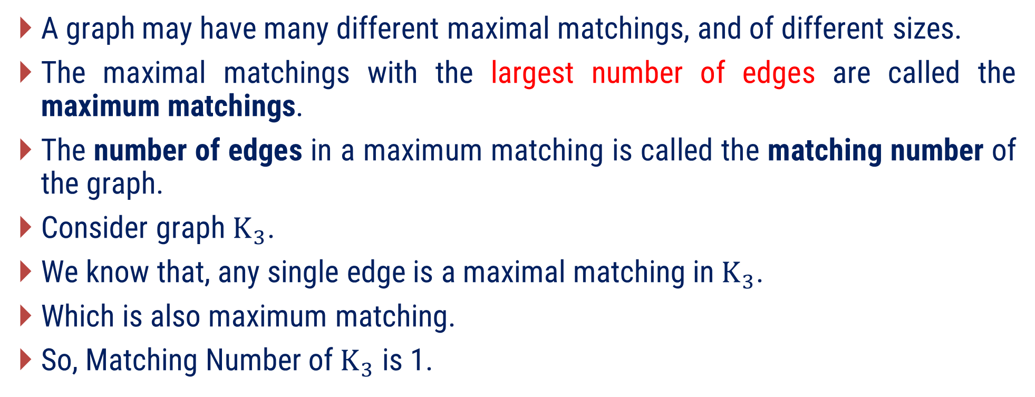
Maximum Matching
A graph may have many different maximal matchings, and of different sizes.
The maximal matchings with the largest number of edges are called the maximum matchings.
The number of edges in a maximum matching is called the matching number of the graph.
Consider graph$K_{3}$.
We know that, any single edge is a maximal matching in$K_{3}$.
Which is also maximum matching.
So, Matching Number of$K_{3}$ is 1.

Slide 50



Find Matching Number of following graph.
Lets consider some matching of G.
G
$$M_{1}$$
$$M_{2}$$
$$M_{3}$$

Slide 51
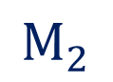

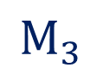
Find Matching Number of following graph.
Now we check which of the following matching are maximal.
$$M_{1}$$
$$M_{2}$$
$$M_{3}$$
G
Not maximal matching.
Maximal matching.
Maximal matching.

Slide 52
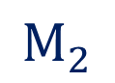
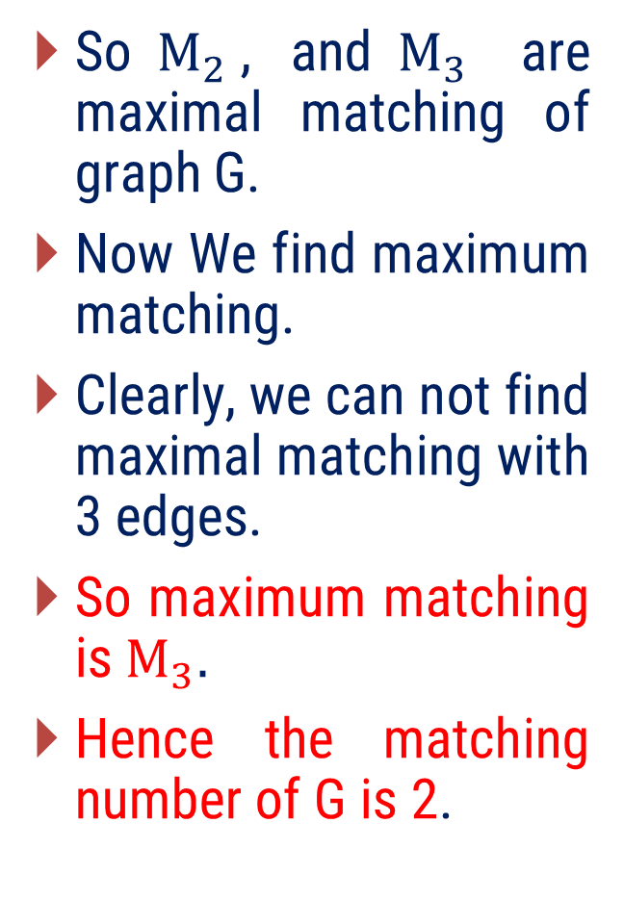

Find Matching Number of following graph.
So$M_{2}$, and$M_{3}$ are maximal matching of graph G.
Now We find maximum matching.
Clearly, we can not find maximal matching with 3 edges.
So maximum matching is$M_{3}.$
Hence the matching number of G is 2.
$$M_{2}$$
$$M_{3}$$
G
Not Maximum matching.
Maximum matching.

Slide 53
Examples of Method-3

Slide 54
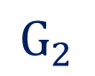

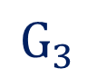
Method 3 ⇝ Example 1
Find any three matching of the following graphs.
Solution
$$G_{1}$$
$$G_{2}$$
$$G_{3}$$

Slide 55




Method 3 ⇝ Example 1(Cont.)
Find any three matching of the following graphs.
Solution
$$G_{1}$$
$$M_{1}$$
$$M_{2}$$
$$M_{3}$$

Slide 56




Method 3 ⇝ Example 1(Cont.)
Find any three matching of the following graphs.
Solution
$$G_{2}$$
$$M_{1}$$
$$M_{2}$$
$$M_{3}$$

Slide 57




Method 3 ⇝ Example 1(Cont.)
Find any three matching of the following graphs.
Solution
$$M_{1}$$
$$M_{2}$$
$$M_{3}$$
$$G_{3}$$

Slide 58


Method 3 ⇝ Example 2
Find a matching of the following graphs.
Solution
h
h
i
g
f
e
d
e
f
g
c
a
c
d
b
b
a
$$G_{1}$$
$$G_{2}$$

Slide 59



Method 3 ⇝ Example 2(Cont.)
Find a matching of the following graphs.
Solution
Possible matching of$G_{1}$(if we select)$d,$
are $\left\{d\right\}$,$\left\{d,b\right\},\left\{d,i\right\},$and$\left\{d,b,i\right\}$.
h
i
g
d
$$M_{1}=\left\{d,b,i\right\}$$
e
f
c
b
a
$$G_{1}$$

Slide 60

Method 3 ⇝ Example 2(Cont.)
Find a matching of the following graphs.
Solution
h
f
e
$$M_{1}=\left\{f,b\right\}$$
g
c
a
d
b
$$G_{2}$$

Slide 61

Method 3 ⇝ Example 3
Find any two maximal matching of the following graphs.
Solution
h
i
g
d
e
f
c
b
a
$$G$$

Slide 62



Method 3 ⇝ Example 3
Find any two maximal matching of the following graphs.
Solution
h
i
h
i
h
i
g
g
g
d
d
d
e
f
e
f
e
f
c
c
c
b
a
b
a
b
a
Maximal matching $M_{1}$(As we can not any edge from graph )
Maximal matching $M_{2}$(As we can not any edge from graph )
$$G$$

Slide 63
Method 3 ⇝ Example 4
Find matching number of the following graphs.
Solution
h
i
g
d
e
f
c
b
a
$$G$$

Slide 64




Method 3 ⇝ Example 4(Cont.)
Find matching number of the following graphs.
Solution
Consider graph with two maximal matching $M_{1}$ and$M_{2}$ of it.
Here$M_{1}$ and $M_{2}$ both are maximal but $M_{1}$ is largest in size so,${ M}_{1}$is maximum matching.
Size of $M_{1}$ is 3.
Hence, Matching number of graph is 3.
i
h
i
g
d
d
e
f
e
f
c
b
b
a
$$M_{1}$$
$$M_{2}$$
$$G$$
Maximum matching
Not Maximum matching

Slide 65




Method 3 ⇝ Example 5
Find matching number of the following graphs.
Solution
Consider graph with two maximal matchings$M_{1}$and $M_{2}$.
Here, $M_{1}$ is maximum but $M_{2}$ is not maximum.
Hence matching number is 3.
f
e
h
e
f
h
a
g
d
c
b
b
b
$$M_{2}$$
$$M_{1}$$
$$G$$

Slide 66
Method – 4 Perfect Matching and Hall’s Theorem (without proof)

Slide 67



Perfect Matching
A matching of a graph in which every vertex is matched is called perfect matching.
OR
A matching for which degree of each vertex is 1 is called perfect matching.
a
a
a
a
c
b
c
b
c
b
c
b
G
$$M_{1}$$
$$M_{2}$$
$$M_{3}$$
So, for$K_{3}$, $M_{1}, M_{2},$and $M_{3}$are not perfect matching

Slide 68





Perfect Matching
A matching for which degree of each vertex is 1 is called perfect matching.
G
$$M_{1}$$
$$M_{2}$$
$$M_{3}$$
$$M_{4}$$
So, for$G, M_{2}, and M_{3}$are perfect matching but,
$M_{1},$and $M_{4}$are not perfect matching.

Slide 69

Is Perfect matching possible for graph with odd order?
From definition,
In a perfect matching, the degree of each vertex is 1.
So, a perfect matching of a graph is a matching where every vertex of the graph is connected to exactly one edge in the matching.
That means, a perfect matching has$\frac{n}{2}$edges (where$n$ is the number of vertices).
Therefore, perfect matchings are only possible in graphs with an even number of vertices.
Hence, perfect matching is not possible for graph with odd order.

Slide 70



Is Perfect matching possible for all graph with even order?
No perfect matching is not possible for all graph with even order.
Consider following graph with all of its possible matching,
$$M_{1}$$
$$M_{2}$$
$$M_{3}$$
Hence perfect matching is not possible for all graph with even order

Slide 71
Real life situation can be modeled by a graph
A mathematics department at a university has acquired a collection of 12 different mathematics books on a variety of subjects to be presented to students who have performed well on a competitive mathematics exam (one book to each successful student).
There would be a problem if more than 12 students qualified for these books.
It turns out, however, that this is not a problem as only 10 students did well enough on the exam to receive books. Nevertheless, another possible difficulty has arisen.
Some of the students already have copies of some books and there are some books that certain students have no need for.

Slide 72
Real life situation can be modeled by a graph
The question is this: Is there a way of distributing 10 of the 12 books to the 10 students so that each student receives a book that he or she would like to have?
The answer to this problem may be no, even though there are more books than students.
For example, there may be three or more books that no student wants.
Also, perhaps there are four students only interested in the same three books, in which case it would be impossible to distribute four books to these four students.

Slide 73
Real life situation can be modeled by a graph
It may already be clear that this situation can be modeled by a graph G whose vertices are the students, say S1, S2, …, S10 and the books, say B1, B2, …, B12.
So, G is a bipartite graph sets U = {S1, S2, …, S10} and W = {B1, B2, …, B12}.
For example, if student S1 would like to have any of the books B2, B3, B5, B7, then the graph G contains the subgraphs shown in Figure.
S1
S2
S3
S4
S5
S6
S7
S8
S9
S10
B1
B2
B3
B4
B5
B6
B7
B8
B9
B10
B11
B12

Slide 74

Model and Solve following real life problem using graph theory
As a result of doing well on an exam, six students (A), (B), (C) , (D) , (E) and (F) have earned the right to receive a complimentary textbook in either algebra (a), calculus (c), differential equations (d), geometry (g), history of mathematics (h), programming (p) or topology (t).
There is only one book on each of these subjects.
The preferences of the students are
$A:d,h,t; B:g,p,t; C:a,g,h; D:h,p,t; E:a,c,d;$and $F:c,d,p.$
Can each of the students receive a book he or she likes?

Slide 75
Model and Solve following real life problem using graph theory
Modeling of problem using graph
A
B
C
D
E
F
a
c
d
g
h
p
t
$A:d,h,t; B:g,p,t; C:a,g,h; D:h,p,t; E:a,c,d;$and $F:c,d,p.$

Slide 76

Model and Solve following real life problem using graph theory
Solution of problem using graph
A
B
C
D
E
F
a
c
d
g
h
p
t
Yes, each of the students receive a book he or she likes

Slide 77
Model and Solve following real life problem using graph theory
Seven seniors (B), (D), (F), (J), (K), (L) and (M) are looking for positions after they graduate.
The University Placement Office has posted open positions for an accountant (a), consultant (c), editor (e), programmer (p), reporter (r), secretary (s) and teacher (t).
Each of the seven students has applied for some of these positions: The preferences of the students for the available subjects are as follows:
Student B prefers c and e. Student D prefers a, c, p, s, and t. Student F prefers c, and r. Student J prefers c, e, and r. Student K prefers a, e, p, and s. Student L prefers e and r, and Student M prefers p, r, s, and t.
Is it possible for each student to be hired for a job for which he or she has applied?

Slide 78
Model and Solve following real life problem using graph theory
Modeling of problem using graph
B
D
F
J
K
L
M
a
c
e
p
r
s
t
Student B prefers c and e. Student D prefers a, c, p, s, and t. Student F prefers c, and r. Student J prefers c, e, and r. Student K prefers a, e, p, and s. Student L prefers e and r, and Student M prefers p, r, s, and t.

Slide 79

Model and Solve following real life problem using graph theory
Solution of problem using graph
B
D
F
J
K
L
M
a
c
e
p
r
s
t
No, it is not possible for each student to be hired for a job for which he or she has applied

Slide 80

Observation
We observe that there is a subset$X = \left\{B, F, J, L\right\}$ of seven seniors containing four vertices, whose neighbors belong to a set$\left\{c, e, r\right\}$ of only three vertices.
As we are about to see, this is the key reason why this does not contain a matching.
So, next we state related theorem in the context of bipartite graphs.

Slide 81

Hall’s Theorem (without proof)
Statement:
Let $G$be a bipartite graph with partite sets $U$and $W$such that, $r=|U|≤\left|W\right|$.
Then $G$contains a matching of size $r$if and only if $G$satisfies Hall’s condition.
Hall’s condition:
The graph $G$ is said to satisfy Hall’s condition if $\left|N\left(X\right)\right|≥\left|X\right|$for every nonempty subset $X$of $U$. This condition is named for Philip Hall.
Hall’s Theorem tells us when we can have the perfect matching.

Slide 82


Illustration: Hall’s condition
The graph $G$ is said to satisfy Hall’s condition if $\left|N\left(X\right)\right|≥\left|X\right|$for every nonempty subset $X$of $U$.
If we take$X=\left\{B,F,J,L\right\}$.
So, $\left|X\right|=4.$
But,$N\left(X\right)=\left\{c,e,r\right\}.$
So,$\left|N\left(X\right)\right|=3.$
$i.e. \left|N\left(X\right)\right|<\left|X\right|$.
Hence graph is not satisfy Hall’s condition.
B
D
F
J
K
L
M
a
c
e
p
r
s
t

Slide 83


Apply Hall’s Theorem on Given Graph.
Let G be a bipartite graph with partite sets U and W such that, $r=|U|≤|W|.$
Then 𝐆 contains a matching of size 𝐫 if and only if G satisfies Hall’s condition.
Consider a bipartite graph with partite sets U and W such that, $7=\left|U\right|$and $\left|W\right|=7.$
So, $r=7=\left|U\right|≤\left|W\right|.$
As we know G not satisfied Hall’s condition Therefor 𝐆 does not contains a matching of size 7.
So, we can not get perfect matching for given graph.
B
D
F
J
K
L
M
a
c
e
p
r
s
t

Slide 84

Hall’s Theorem Application.
In this diagram, a bipartite graph, the students are at the top and the companies are at the bottom. A student and a company is connected if the company wants to hire the student. For example, d will hire any student, so d is connected to A, B, C, and D. Can every student gets a job?
For answer to this question we apply Hall’s theorem.
Here if we take$X=\left\{A,B,D\right\}$ then$N\left(X\right)=\left\{b,d\right\}$.
So,$\left|X\right|>\left|N\left(X\right)\right|$.
i.e. Graph not satisfy Hall’s condition.
Hence, We can not find perfect matching of size 4.
So every students can not gets job.
A
B
C
D
a
b
c
d

Slide 85
Hall’s Theorem Application.
Two groups of 7 cricket teams are set to play one-on-one matches — each team from Group A must play against exactly one distinct team from Group B. Matches are allowed only if both teams agree to play (i.e., there's an edge between them).
Using Hall's Theorem, determine whether it is possible to schedule 7 distinct matches (1 from each team in Group A to 1 distinct team in Group B).
Is it possible that India plays against Pakistan in such a matching?
Group A (Home Teams):
India (IND)
Sri Lanka (SL)
New Zealand (NZ)
South Africa (SA)
Australia (AUS)
England (ENG)
Bangladesh (BAN)
Group B (Away Teams):
Pakistan (PAK)
West Indies (WI)
Afghanistan (AFG)
Ireland (IRE)
Namibia (NAM)
Netherlands (NED)
Scotland (SCO)
Edges (Match Preferences):
(A1) India → Pakistan (B1), West Indies (B2), Afghanistan (B3)
(A2) Sri Lanka → West Indies (B2), Afghanistan (B3), Ireland (B4)
(A3) New Zealand → Ireland (B4), Namibia (B5)
(A4) South Africa → Namibia (B5), Netherlands (B6)
(A5) Australia → Netherlands (B6), Scotland (B7)
(A6) England → Afghanistan (B3), Scotland (B7)
(A7) Bangladesh → Pakistan (B1), Netherlands (B6)

Slide 86
Hall’s Theorem Application.
First we model problem into graph.
Edges (Match Preferences):
(A1) India → Pakistan (B1), West Indies (B2), Afghanistan (B3)
(A2) Sri Lanka → West Indies (B2), Afghanistan (B3), Ireland (B4)
(A3) New Zealand → Ireland (B4), Namibia (B5)
(A4) South Africa → Namibia (B5), Netherlands (B6)
(A5) Australia → Netherlands (B6), Scotland (B7)
(A6) England → Afghanistan (B3), Scotland (B7)
(A7) Bangladesh → Pakistan (B1), Netherlands (B6)
A1
A2
A3
A4
A5
A6
A7
B1
B2
B3
B4
B5
B6
B7

Slide 87


Hall’s Theorem Application.
Solution.
After observation, we can not find$X$ for $N(X)$ is small in size.
So, graph must satisfy Hall’s condition.
Hence, it is clear from Hall’s theorem graph have perfect matching.
i.e. it is possible to schedule 7 distinct matches.
Also, India be matched with Pakistan as, India is connected to Pakistan and There exists a perfect matching.
So at least one such matching can include India vs. Pakistan.

Slide 88
Hall’s Theorem Application.
Now we find such perfect matching.
A1
A2
A3
A4
A5
A6
A7
B1
B2
B3
B4
B5
B6
B7

Slide 89
Examples of Method-4

Slide 90

Method 4 ⇝ Example 1
Prove that every tree has at most one perfect matching.
Solution
For the basis step,
A tree with one vertex has no perfect matching;
A tree with two vertices has one perfect matching.
For the Assumption step,
Suppose, a tree with $n−1$vertices has at most one perfect matching.

Slide 91

Method 4 ⇝ Example 1(Cont.)
Prove that every tree has at most one perfect matching.
Solution
For the induction step,
Consider an arbitrary tree$T$, with$n>2$vertices, and consider a leaf$v$.
In any perfect matching,$v$ must be matched to its neighbor$u$.
Since each perfect matching in$T$, must contain the edge$uv$.
So, the number of perfect matchings in$T$ is equals to the number of perfect matchings in$T−\left\{u,v\right\}$.
Each component of$T−\left\{u,v\right\}$ is a tree with$n−1$ vertices;
Therefore by the induction hypothesis,
Hence, Tree has at most one perfect matching.

Slide 92
Method 4 ⇝ Example 2
Give an example of a graph that has a perfect matching, but its matching number is 1.
Give an example of a graph whose matching number is 1, but it does not have a perfect matching.
Solution
For (a)
Clearly graph have perfect matching as in matching of graph degree of each vertex is 1 also size of maximum matching is 1 so, matching number is 1.

Slide 93
Method 4 ⇝ Example 2(Cont.)
Give an example of a graph that has a perfect matching, but its matching number is 1.
Give an example of a graph whose matching number is 1, but it does not have a perfect matching.
Solution
For (b)
Clearly graph does not have perfect matching as in matching of graph degree of each vertex is not 1 but matching number is 1 as maximum matching size is 1.

Slide 94

Method 4 ⇝ Example 3
Give nine perfect matchings of the following graph.
Solution
$$G$$

Slide 95



Method 4 ⇝ Example 3(Cont.)
Give nine perfect matchings of the following graph.
Solution
$M_{1}$
$$M_{2}$$
$$M_{3}$$

Slide 96
Method 4 ⇝ Example 3(Cont.)
Give nine perfect matchings of the following graph.
Solution
$M_{1}$
$$M_{2}$$
$$M_{3}$$

Slide 97
Method 4 ⇝ Example 3(Cont.)
Give nine perfect matchings of the following graph.
Solution
$M_{1}$
$$M_{2}$$
$$M_{3}$$

Slide 98

Method 4 ⇝ Example 3(Cont.)
Give nine perfect matchings of the following graph.
Solution

Slide 99

Method 4 ⇝ Example 4
Prove that if a graph have perfect matching then order of graph is even.
Solution
Suppose a graph of order $n$ has a perfect matching.
This means the graph has a matching in which the degree of each vertex is exactly 1.
By applying the Degree Sum Formula to this matching,
The total sum of degrees of all vertices involved in the matching is$n.$
As we know total sum of degrees of all vertices is always even.
That means,$n$ is even.
Hence, a graph have perfect .matching then order of graph is even.

Slide 100

B.Tech. $→5$^{th} Semester
Graph Theory (2301HS301)
THANK YOU
Prof. Punit Vadher
Department of Humanities & Science
punit.vadher@darshan.ac.in
9662443859

